Slide 1
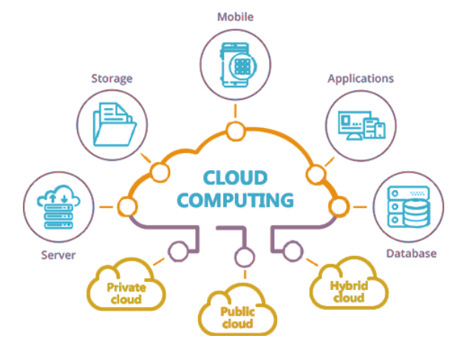
Key Essesntials for Building Apps in Cloud
Ravindu Nirmal Fernando
SLIIT | March 2025
https://ravindunfernando.com

Slide 2
Shared Responsibility Model in Public Cloud
A framework that outlines how security responsibilities are divided between the cloud service provider and the cloud user.
Security and compliance is a shared responsibility between AWS and the customer. Cloud service provider manages the infrastructure, while customers are responsible for managing their data and applications.
Cloud Service Provider (CSP) Responsibility: Known as "Security of the Cloud." CSP is in charge of the infrastructure, including hardware, software, networking, and physical security.
Customer Responsibility: Termed "Security in the Cloud." Customers handle the guest operating system, application software, and AWS-provided firewall configuration.

Slide 3
Key aspects of Shared Responsibility Model
Service/ Delivery Models: Responsibilities vary depending on whether the service is IaaS (like EC2), PaaS, or SaaS.
IT Controls: Shared management of IT controls between CSP and customers. CSP manages physical infrastructure controls, while customers handle specific application-level controls.

Slide 4
Control types in Shared Responsibility Model
Inherited Controls: Controls fully managed by CSP (e.g., physical and environmental controls).
Shared Controls: Controls that apply to both CSP and customers but in different contexts (e.g., patch management, configuration management).
Patch Management – CSP is responsible for patching and fixing flaws within the infrastructure, but customers are responsible for patching their guest OS and applications.
Configuration Management – CSP maintains the configuration of its infrastructure devices, but a customer is responsible for configuring their own guest operating systems, databases, and applications.
Awareness & Training - CSP trains CSP’s employees, but a customer must train their own employees.
Customer Specific Controls: Controls solely managed by the customer, depending on their applications and use of CSP services.

Slide 5
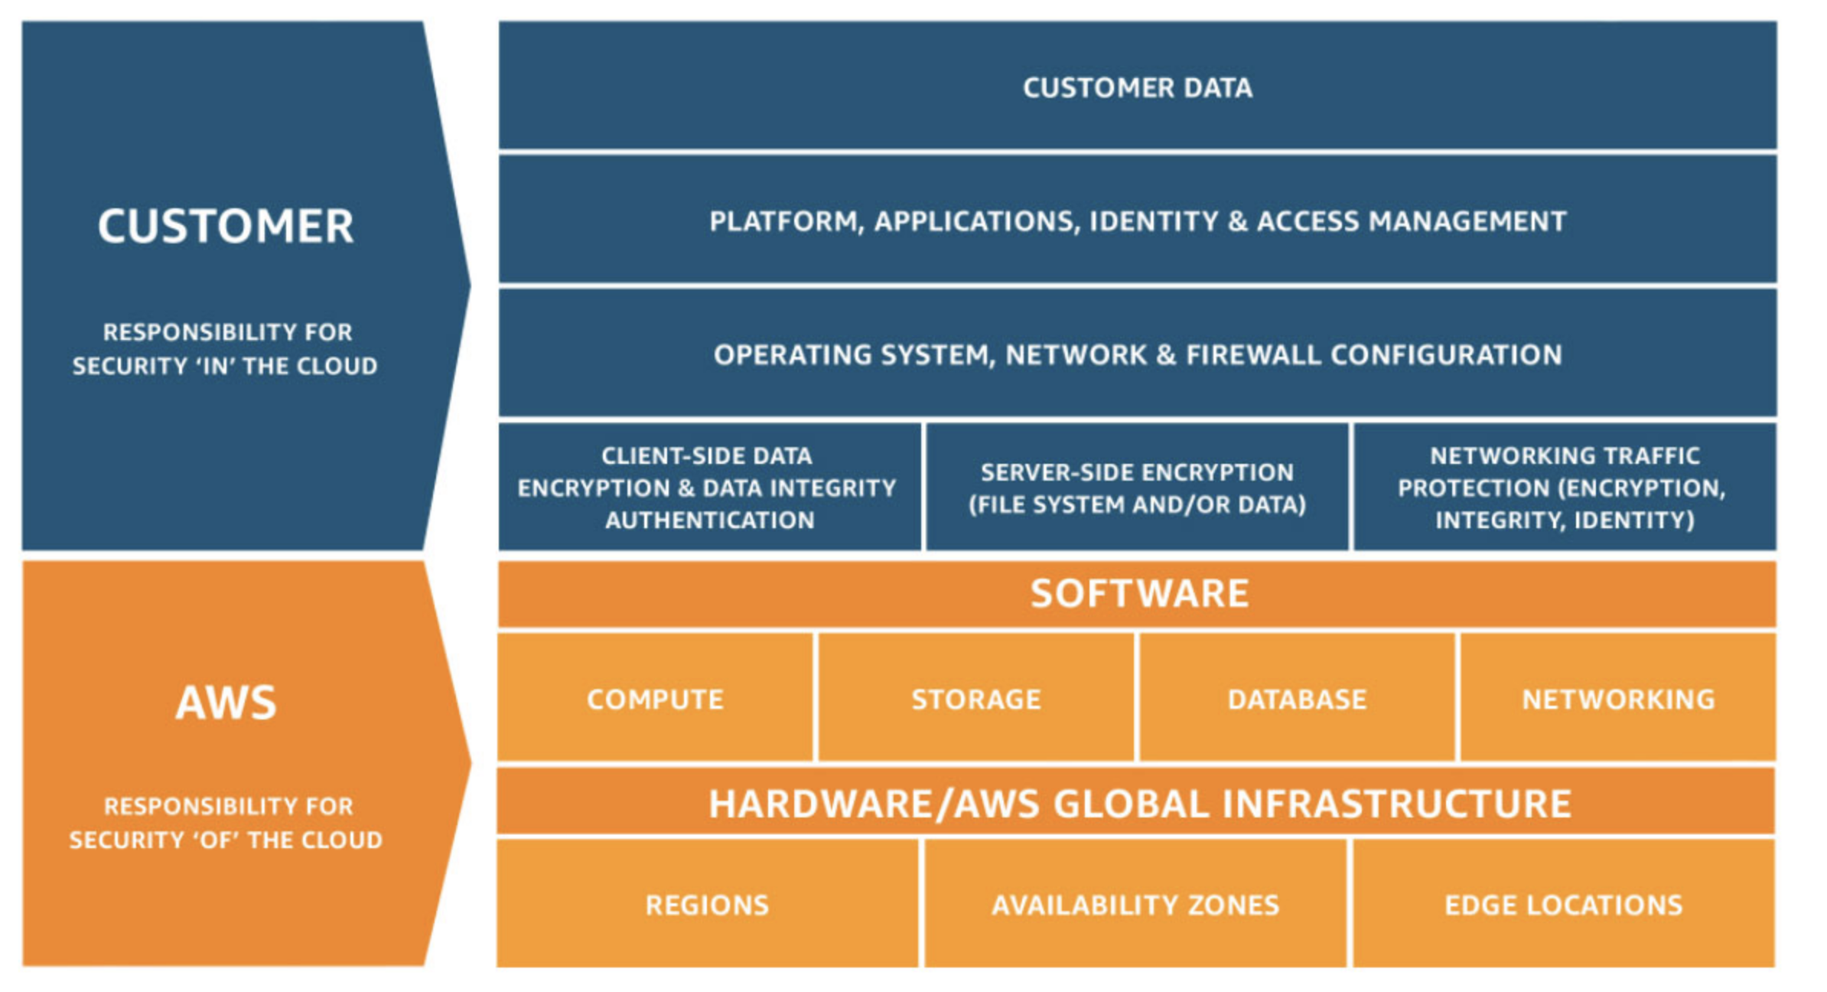

Slide 6
How to use Shared Responsibility Model practically…
Understanding the Model: Customers need to comprehend the CSP Shared Responsibility Model and its general application in cloud operations.
Application to Use Case: Determine the model's relevance to their specific use case.
Variability in Responsibility: Customer responsibility changes based on:
The choice of CSP services and geographical locations. (e.g: AWS EC2 in specified AWS region)
How these services integrate into their IT environment.
Legal and Regulatory Considerations: Consideration of laws and regulations that apply to their organization and workload.

Slide 7
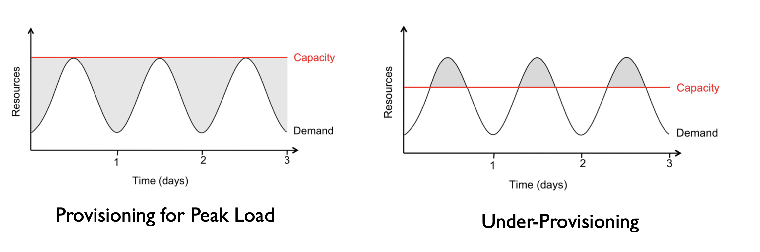
Resource Provisioning
Reference: Above the Clouds: A Berkeley View of Cloud Computing, 2009.

Slide 8
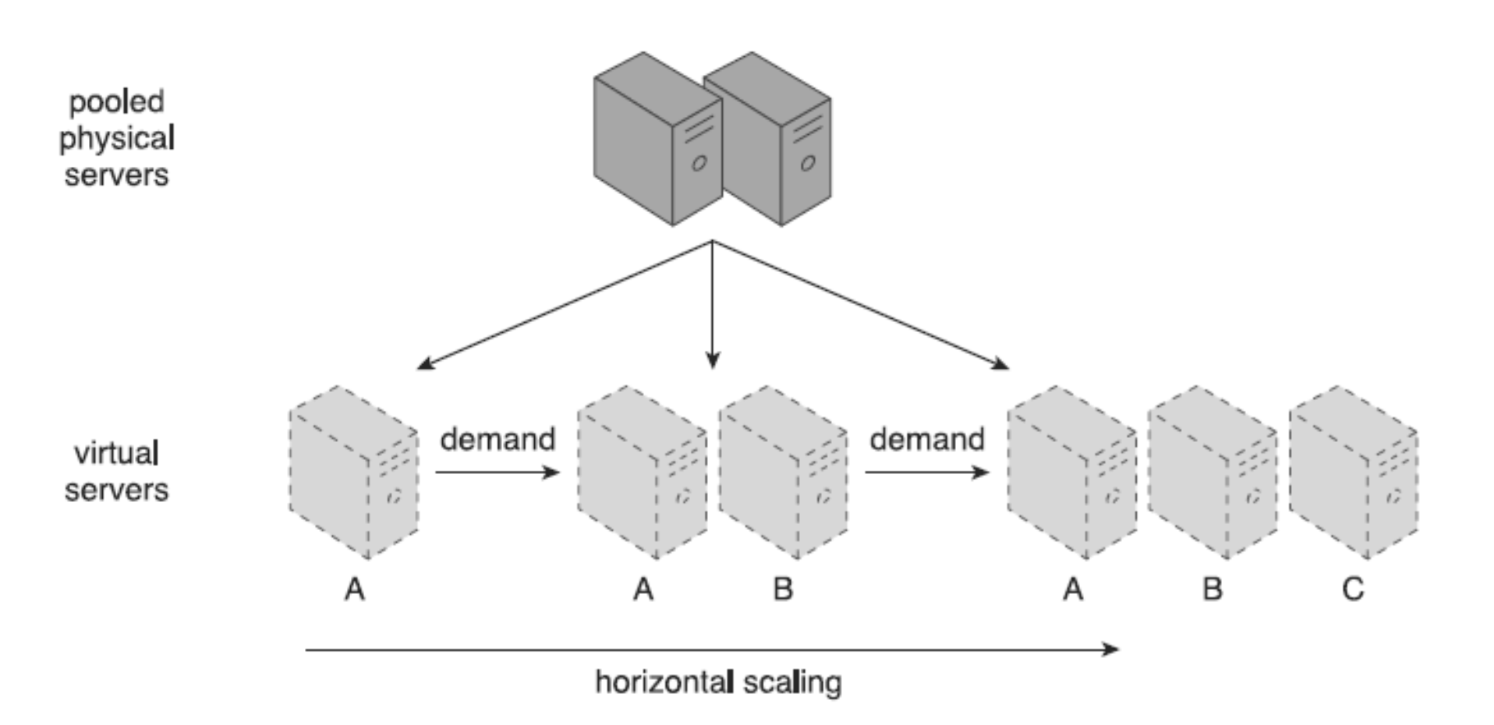
Scalability in Cloud
Horizontal scaling
The allocating or releasing of IT resources that are of the same type
Scaling in and out

Slide 9
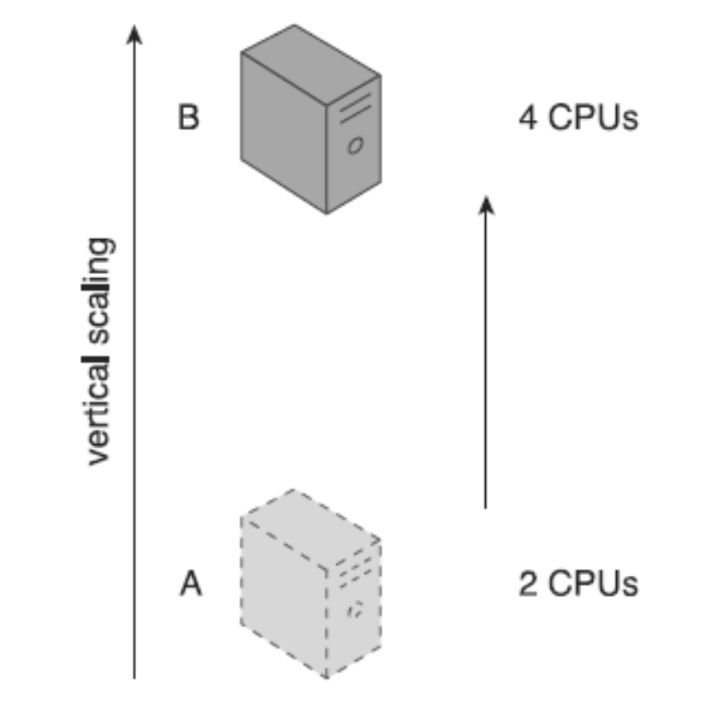
Vertical scaling
Existing IT resource is replaced by another with higher or lower capacity
Scaling up & down

Slide 10
Horizontal vs Vertical Scaling
Aspect | Horizontal Scaling (Scaling Out/In) | Vertical Scaling (Scaling Up/Down)
Definition | Adding or removing servers to adjust capacity. | Increasing or decreasing the capacity of a server.
Cost | Can be more cost-effective with pay-as-you-go models. | May involve higher costs due to high-end hardware.
Downtime | Often allows scaling with no downtime. | May require downtime for hardware upgrades.
Resource Limits | Limited by the number of servers you can add. | Limited by the maximum capacity of a single server.
Complexity | Can increase architectural complexity. | Simpler, as it involves a single resource.
Availability | Improved, as load is distributed across multiple servers. | Risk of a single point of failure.
Use Case | Ideal for distributed systems and microservices. | Suited for applications with fixed or known peaks.

Slide 11
Reactive scaling
Once something (e.g., workload) happen
Proactive scaling
Based on predictions (e.g., workload)
Based on
Rules
Spawn a new VM if ave. CPU util. > 80%
Models based on QoS/SLA targets
No of VMs to maintain latency < 300 ms

Slide 12
Cloud Security Basics and Countermeasures
Based on Cloud Computing: Concepts, Technology Architecture, Thomas Erl, et al., Prentice‐Hall, 2013,

Slide 13
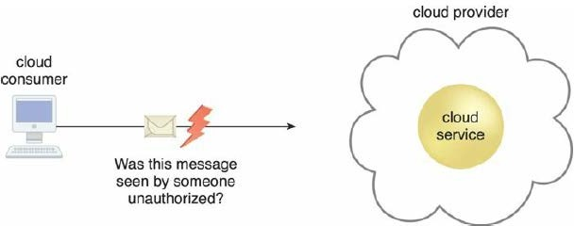
Concepts
Confidentiality
Accessible only to authorized parties
Within cloud environments, confidentiality targets to restricting access to data in transit and storage.

Slide 14
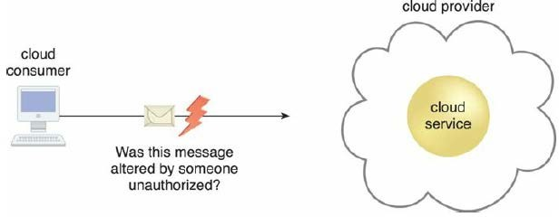
Concepts
Integrity
Not having been altered by an unauthorized party
Can cloud consumer be guaranteed transmitted data to matches the data received.
Extends to how data is stored, processed, and retrieved.

Slide 15
Concepts
Authenticity
Ensuring something has been provided by an authorized source.
Can cloud consumer guarantee the authentication of an interaction and no other party can deny or challenge that.
Availability
Being accessible, available and usable within defined time period.
In cloud the availability of cloud services can be a responsibility that is shared by the cloud provider and the cloud carrier. The availability of a cloud-based solution that extends to cloud service consumers is further shared by the cloud consumer.

Slide 16
Threat Agents
An entity that poses a threat because it is capable of carrying out an attack.
Can originate either internally or externally.
Human or Software.

Slide 17
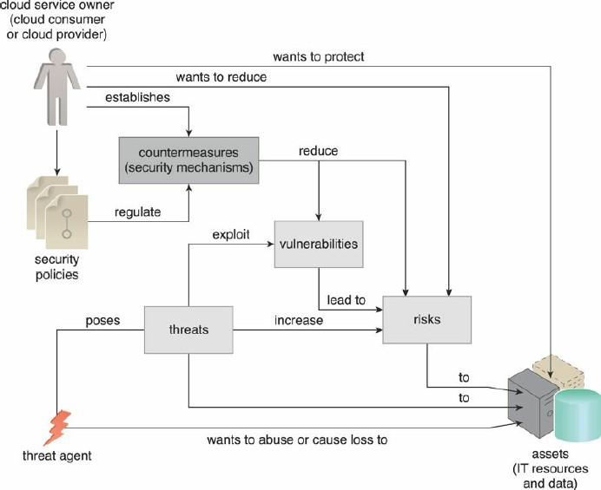
Threat Agents

Slide 18
Threat Agents
Anonymous Attacker
Non-trusted cloud service consumer without permissions in the cloud. Attempts attacks from outside cloud permission boundary, mostly using public networks.
Malicious Service Agent
Able to intercept and forward the network traffic that flows within a cloud. Then to maliciously use and augment the data.
Trusted Attacker
Shares IT resources in the same cloud environment as the cloud consumer and attempts to exploit legitimate credentials to target cloud providers and the cloud tenants.
Malicious Insider
Human threat agents acting on behalf of or in relation to the cloud provider. Typically current or former employees or third parties with access to the cloud provider’s premises.

Slide 19
Cloud Security Threats
Traffic Eavesdropping
Malicious Intermediary
Denial of Service
Insufficient Authorization
Virtualization Attack
Overlapping Trust Boundaries

Slide 20
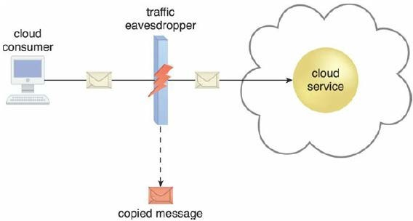
Traffic Eavesdropping
Data transferred to or within a cloud is passively intercepted by a malicious service agent for information gathering purposes.
Aim to compromise the confidentiality of the data.
Due to passive nature of the attack, it can take place undetected for extended periods of time.

Slide 21
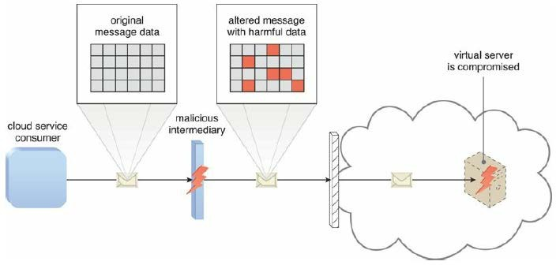
Malicious Intermediary
Messages are intercepted and altered by a malicious service agent.
Potentially compromising the message’s confidentiality and/or integrity.
May insert harmful data into the message.

Slide 22
Denial of Service
Overload IT resources to the point where they cannot function properly.
The workload on cloud services is artificially increased with imitation messages or repeated communication requests.
The network is overloaded with traffic to reduce its responsiveness and cripple its performance.
Multiple cloud service requests are sent, each of which is designed to consume excessive memory and processing resources.

Slide 23
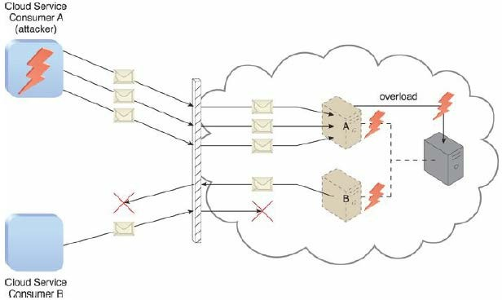
Denial of Service

Slide 24
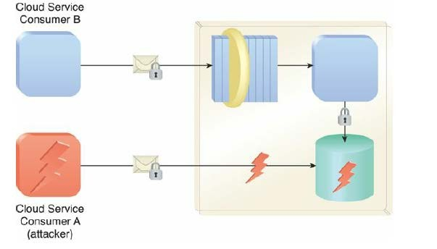
Insufficient Authorization
Occurs when access is granted to an attacker erroneously or too broadly to IT resources that are normally protected.
Result of the attacker gaining direct access to IT resources that were implemented to be accessed by trusted consumer programs.

Slide 25
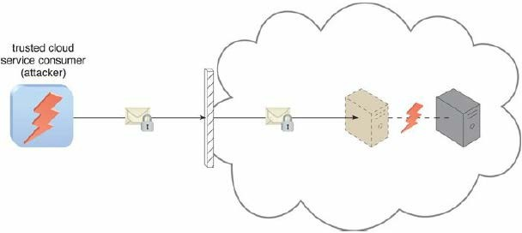
Virtualization Attack
Exploits vulnerabilities in the virtualization platform to jeopardize its confidentiality, integrity, and/or availability.

Slide 26
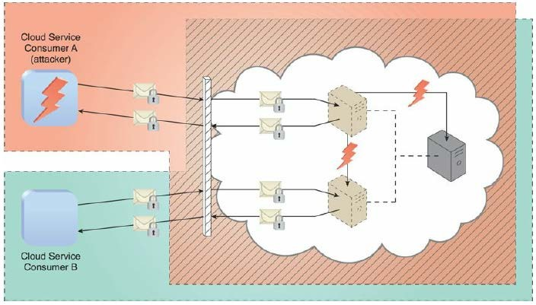
Overlapping Trust Boundaries
Target shared IT resources with the intention of compromising cloud consumers or other IT resources that share the same trust boundary

Slide 27
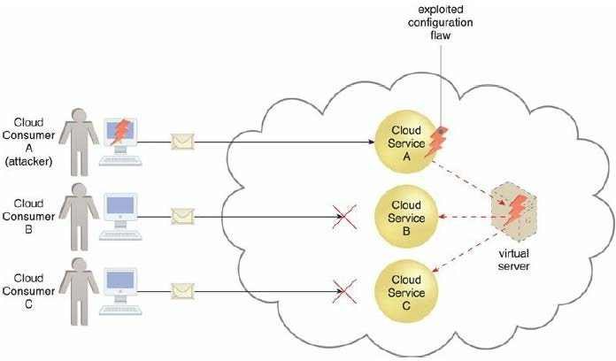
Checklist on Cloud Security
Substandard design, implementation or configuration
Security issues may arise beyond runtime exception or system failures
Attackers may exploit these vulnerabilities

Slide 28
Checklist on Cloud Security (Cont)
Security policy checks
Check for any disparity as majority of the IT resources are now managed by cloud service providers
Contracts
Examine contracts and SLAs put forth by cloud providers to ensure that security policies, and other relevant guarantees, are satisfactory when it comes to security
Risk Management
Continuous risk assessment as part of risk management strategy

Slide 29
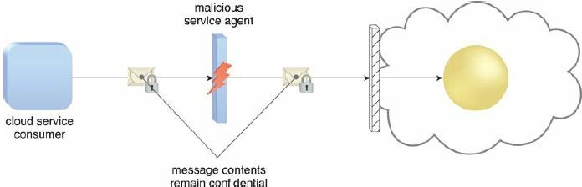
Cloud Security Countermeasures
Encryption
Secret key based encryption mechanisms to counter traffic eavesdropping, malicious intermediary, insufficient authorization, and overlapping trust boundaries security threats.

Slide 30
Encryption
Symmetric Encryption
Secret key cryptography, uses the same key for both encryption and decryption
Does not have the characteristic of non-repudiation, cannot determining which party performed the message encryption or decryption
Asymmetric Encryption
Relies on the use of two different keys, private key and a public key
private key is known only to its owner while the public key is commonly available
Doesn’t provide message integrity or authenticity protection due to the communal nature of the public key

Slide 31
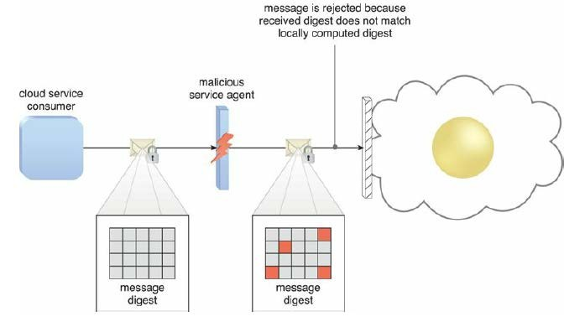
Hashing
When non-reversible form of data protection is required
Derive a hashing code or message digest from a message
Sender attach message digest to the message
Recipient applies the same hash function to the message to verify that the produced message digest is identical to the one that accompanied the message

Slide 32
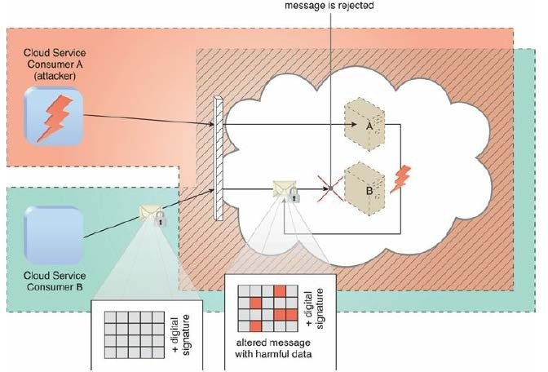
Digital Signature
Messages are assigned a digital signature prior to transmission, which is then rendered invalid if the message experiences any unauthorized modifications
Both hashing and asymmetrical encryption are involved in the creation of a digital signature

Slide 33
Public Key Infrastructure (PKI)
Used to associate public keys with their corresponding key owners
Rely on the use of digital certificates, which are digitally signed data structures that bind public keys to certificate owner identities with a validity time period
Digital certificates are usually digitally signed by a third- party certificate authority

Slide 34





DECRYPTION
Request
Private Key
Sends her public key to encrypt the message
Encrypts and sends the Secure message
Public Key
Private Key
Public Key
Can be distributed to anyone
Will be always private

Slide 35
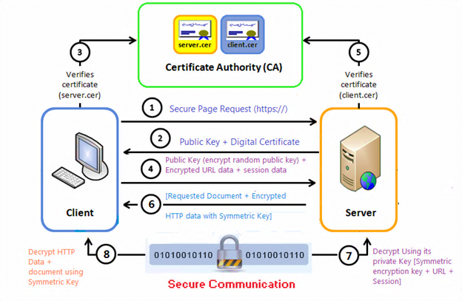

Slide 36
Identity Access Management (IAM)
IAM encompasses controlling and tracking user identities and access in IT environments.
Authentication: Manages credentials like usernames, passwords, digital signatures, biometric data, and binds accounts to specific hardware or software identifiers.
Authorization: Defines access control levels and manages relationships between user identities, access rights, and resource availability.
User Management: Involves administrative tasks like creating user accounts, resetting passwords, setting password policies, and managing privileges.
Credential Management: Establishes and manages access rules for user accounts to prevent unauthorized access.

Slide 37
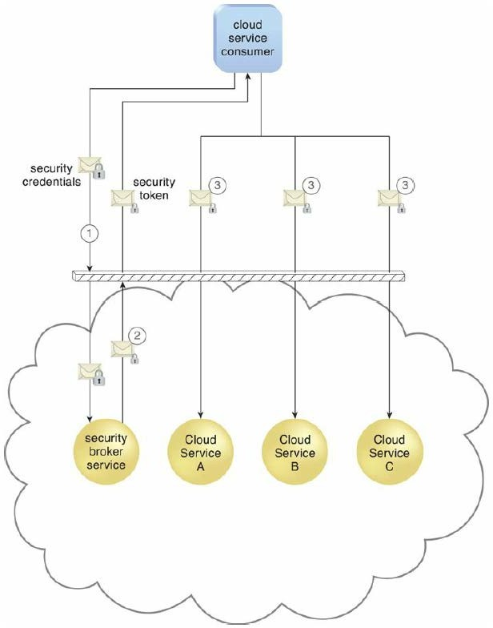
Single Sign-On (SSO)
Propagating the authentication information across multiple cloud services can be a challenging
Enables authentication by a security broker that establish a persisted security context during consumer accesses to cloud services

Slide 38
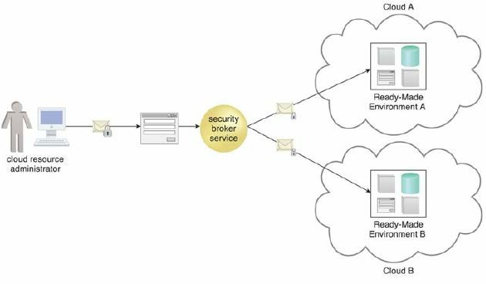
Single Sign-On (SSO)

Slide 39
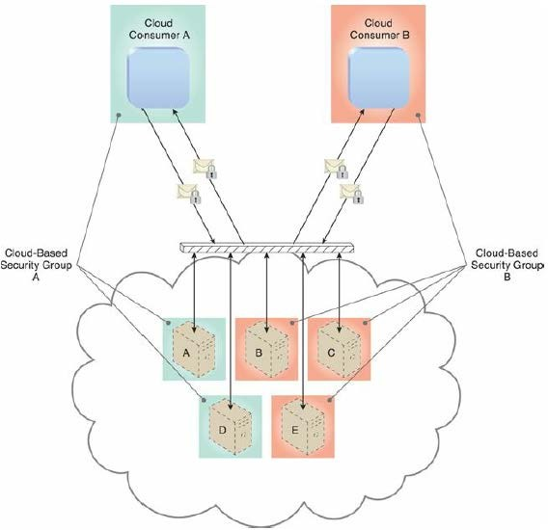
Cloud-Based Security Groups
Cloud resource segmentation is a process by which separate physical and virtual IT environments are created for different users and groups

Slide 40
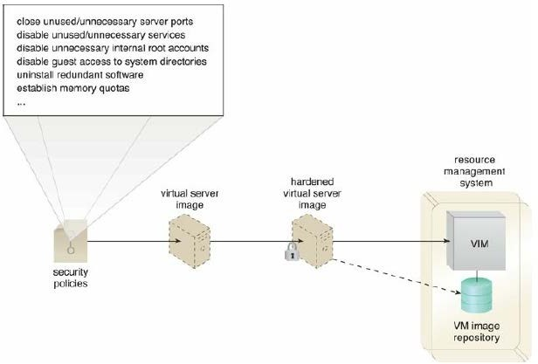
Hardened Virtual Server Images
Process of stripping unnecessary software to limit potential vulnerabilities that can be exploited by attackers
Removing redundant programs, closing unnecessary server ports, and disabling unused services, internal root accounts, and guest access

Slide 41
References
https://aws.amazon.com/compliance/shared-responsibility-model/
Chapter 6 and 10, Cloud Computing: Concepts, Technology & Architecture, Thomas Erl, et al., Prentice‐ Hall, 2013

